Slide 1

Communication System
IICT Lecture 7
FAST NUCES, Lahore

Slide 2
What is Communication?
Communication is the process of exchanging information.
Networking communication encompasses various protocols, technologies, and methods that enable effective data exchange
Internet is network of network, where all devices are linked and can share information
FAST NUCES, Lahore
Notes:
Act of transferring information from one place to another

Slide 3
Characteristics of Communication System
There must be a Sender and Receiver
A protocol is a set of rules which governs the transfer of data between computers. Protocols allow communication between computers and networks.
Protocols will determine the speed of transmission, error checking method, flow control, congestion control and reliability.
FAST NUCES, Lahore

Slide 4
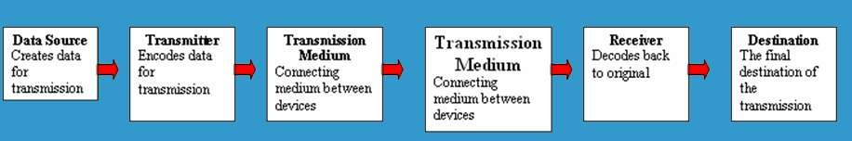
Five Basic Components
Every communication system has 5 basic requirements
Data Source (where the data originates)
Transmitter (device used to transmit data)
Transmission Medium (cables or non cable)
Receiver (device used to receive data)
Destination (where the data will be placed)
FAST NUCES, Lahore

Slide 5
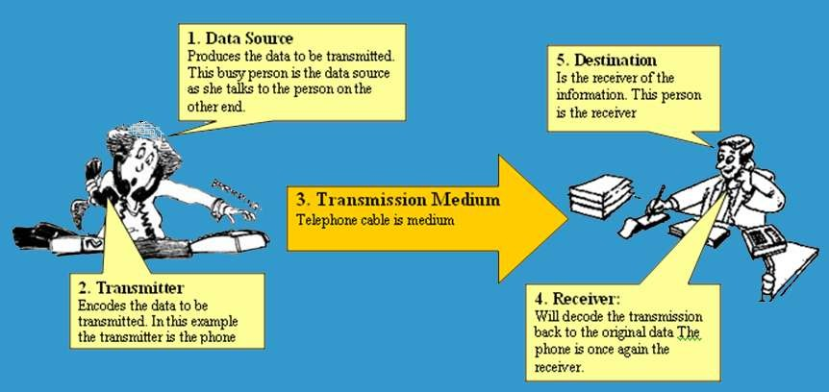

Pictorial Representation
FAST NUCES, Lahore

Slide 6
OSI Model
The Open Systems Interconnection model (OSI model) is a conceptual model that characterizes and standardizes the communication functions of a telecommunication or computing system without regard to its underlying internal structure and technology.
The OSI model also provides much more information which is included with each package.
FAST NUCES, Lahore

Slide 7
7 Layers of OSI Model
OSI “Open System Interconnection”
OSI is not a protocol but a list of protocols divided between 7 layers with each layer having a different set of functions.
Each packet is layered/packaged with protocols from each of the layers as it is processed.
The process of layering the protocols around each package is called encapsulation. The final encapsulated data packet is called a frame.
FAST NUCES, Lahore

Slide 8
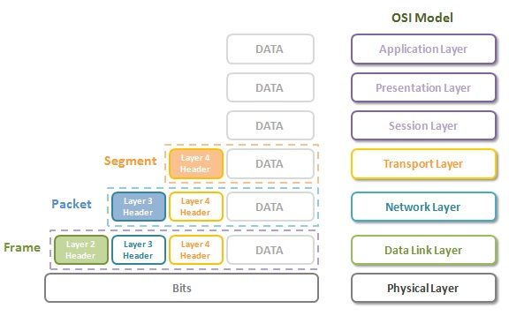
OSI Model
FAST NUCES, Lahore

Slide 9
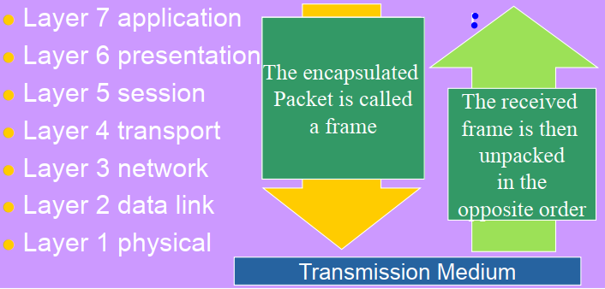
OSI Model
OSI Reference Model
FAST NUCES, Lahore

Slide 10
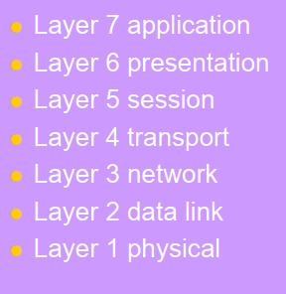
Service Performed at Each Layer
Identification, authentication
Format conversion, encryption/decryption
Set-up coordinate conversation
Ensures error-free transfer
Routing of data through network
Error control and synchronization
Placing signals on the carrier
FAST NUCES, Lahore

Slide 11
Services at Application Layer
Enables user interaction with the network, offering services like file transfer, email, and web browsing.
HTTP/HTTPS (Hypertext Transfer Protocol)→used for web surfing
FTP (File Transfer Protocol)
SMTP (Simple Mail Transfer Protocol)
DNS (Domain Name System)
POP3, IMAP (for email retrieval)
Data at this layer is called message
FAST NUCES, Lahore

Slide 12
Services at Presentation Layer
Translates, encrypts, and compresses data to be transmitted across the network.
Ensures that data is in a readable format for the application layer.
TLS (Transport Layer Security)
JPEG, GIF, PNG (image format standards)
ASCII, EBCDIC (text encoding formats)
FAST NUCES, Lahore
FAST NUCES, Lahore

Slide 13
Services at Session Layer
Manages sessions or connections between applications.
Provides dialog control and synchronization for long-running processes.
Coordinates communication between systems by establishing, managing, and terminating sessions.
FAST NUCES, Lahore
FAST NUCES, Lahore
FAST NUCES, Lahore

Slide 14
Services at Transport Layer
Ensures reliable data transfer between systems. Provides flow control, error control, and segmentation of data.
TCP (Transmission Control Protocol) for reliable transfer of data
UDP for unreliable high speed data (User Datagram Protocol)
Data at this layer is called segment
FAST NUCES, Lahore
FAST NUCES, Lahore
FAST NUCES, Lahore
FAST NUCES, Lahore

Slide 15
Services at Network Layer
Provides logical addressing and routing of data packets between nodes on different networks..
IP (Internet Protocol, both IPv4 and IPv6)
Data at this layer is called packet
FAST NUCES, Lahore
FAST NUCES, Lahore
FAST NUCES, Lahore
FAST NUCES, Lahore
FAST NUCES, Lahore

Slide 16
Services at Link Layer
Ensures error detection and correction for data frames.
Manages access to the shared media via MAC (Media Access Control) addresses.
Data at this layer is called frame
FAST NUCES, Lahore
FAST NUCES, Lahore
FAST NUCES, Lahore
FAST NUCES, Lahore
FAST NUCES, Lahore
FAST NUCES, Lahore

Slide 17
Services at Physical Layer
Transmits raw bits over a physical medium (electrical, optical, or radio signals).
Defines the hardware transmission technologies, data rates, and physical connectors.
FAST NUCES, Lahore
FAST NUCES, Lahore
FAST NUCES, Lahore
FAST NUCES, Lahore
FAST NUCES, Lahore
FAST NUCES, Lahore
FAST NUCES, Lahore

Slide 18
Wired and Wireless Communications
FAST NUCES, Lahore

Slide 19
Wired and Wireless Communication
Wired transmission refers to the transfer of data between devices using a physical medium such as cables (twisted pair cables, coaxial cables, and fiber optic cables).
Pros: High speed, Low latency, Security
Cons: Limited mobility, maintenance, cable clutter
Wireless transmission refers to the transfer of data between devices using electromagnetic waves, such as radio waves, microwaves, or infrared waves, without the need for physical cables.
Pros: Mobility, Scalability
Cons: Interference, Security risks
FAST NUCES, Lahore
FAST NUCES, Lahore

Slide 20
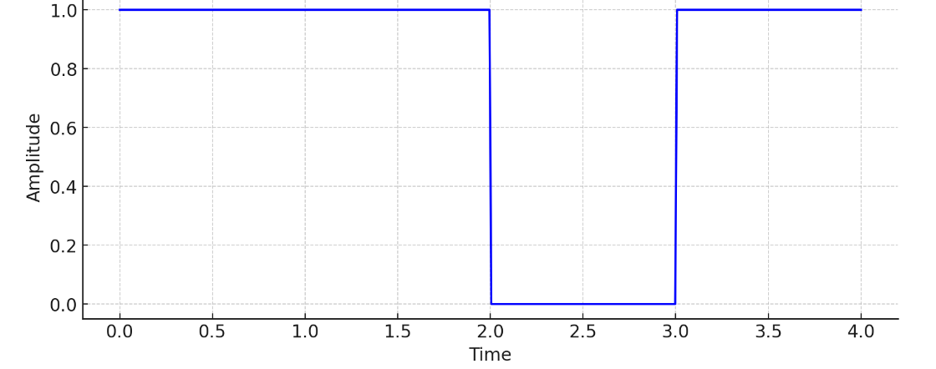
Transmission
Data is transmitted, on a single channel, in the form of signal i.e if 1101 is data it will have following represen- tation.
FAST NUCES, Lahore

Slide 21
Transmission Directions
Simplex: One direction only
Half duplex: Both directions but only one
direction at a time
Full duplex: send and receive both directions at once
FAST NUCES, Lahore

Slide 22
Network Topologies (Wired)
Mesh Topology
Ring Topology
Bus Topology
Star Topology
FAST NUCES, Lahore

Slide 23
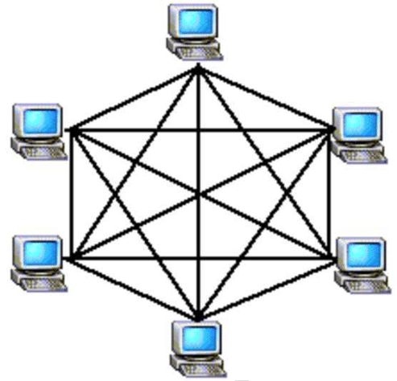
Mesh Topology
FAST NUCES, Lahore

Slide 24
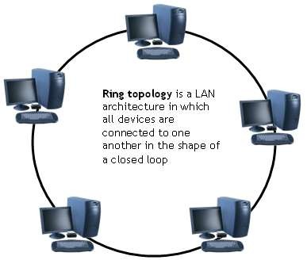
Ring Topology
FAST NUCES, Lahore

Slide 25
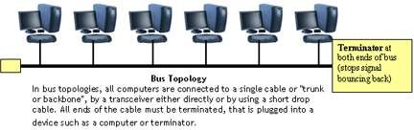
Bus Topology
FAST NUCES, Lahore

Slide 26
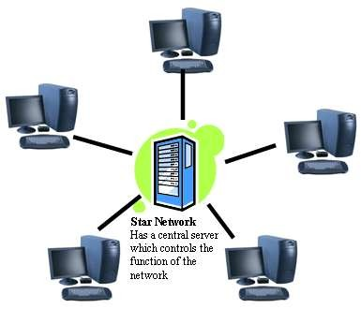
Star Topology
FAST NUCES, Lahore

Slide 27
Network Hardware
FAST NUCES, Lahore

Slide 28
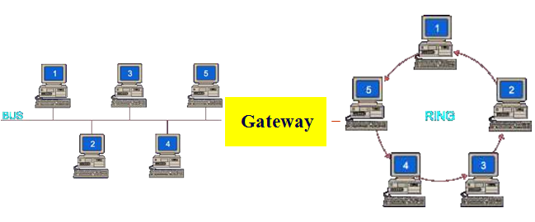
Gateway
Often used to connect a LAN with a WAN.
Gateways join two or More different networks together.
FAST NUCES, Lahore

Slide 29
Some more
Routers: A router is a networking device that forwards data packets between computer networks. Can be used in place of a switch or bridge.
Switches: smart hubs which transmit packets to the
destination port only
Hubs: like double adapters /power boards in the home
except instead of plugging in extension cords we are plugging
in computers to allow them to communicate.
FAST NUCES, Lahore

Slide 30
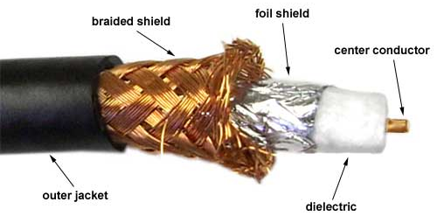
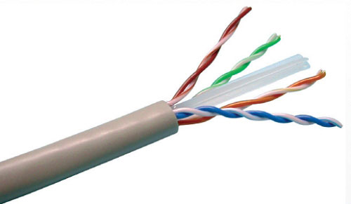
Transmission Media
Twisted pair – Ethernet cable
Coaxial cable –Thick black cable used for higher bandwidth communications than twisted pair (i.e. Optus cable)
Fiber optic – data transferred through pulses of light. Extremely fast.
Coaxial cable
Twisted Pair cable

Slide 31
Wireless Communication (Sender)
The encoded digital signal is modulated to transform the data into a format suitable for transmission over a wireless medium.
The modulated signal is generated and amplified for transmission.
The electromagnetic waves are transmitted through the air to the receiving device. This can be done over various distances, from short-range (like Bluetooth) to long-range (like cellular networks).
FAST NUCES, Lahore

Slide 32
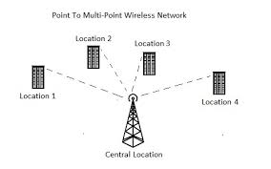
Wireless Communication (Receiver)
The receiving device uses an antenna to capture the transmitted electromagnetic waves.
The strength and quality of the received signal can be affected by distance, interference, and obstacles.
Once the signal is received, it is demodulated to extract the encoded data.
FAST NUCES, Lahore

Slide 33
Frequency and Bandwidth
Frequency refers to the number of cycles a wave completes in one second.
Bandwidth refers to the range of frequencies over which a signal can be transmitted.
Bandwidth determines the data capacity of a communication channel—the wider the bandwidth, the more data can be transmitted at once.
A Wi-Fi channel with 80 MHz bandwidth can transmit data faster than one with 20 MHz bandwidth
FAST NUCES, Lahore

Slide 34
Transmission Rate
Transmission rate, also known as data rate or bit rate, refers to the amount of data that can be transmitted over a communication channel per unit of time.
The transmission rate is usually measured in bits per second (bps), or more commonly in higher units like kilobits per second (Kbps), megabits per second (Mbps), and gigabits per second (Gbps).
A channel with 20Mbps can transfer 20M bits per second.
FAST NUCES, Lahore
FAST NUCES, Lahore

Slide 35
Delay
Delay in communication systems refers to the time it takes for data to travel from the sender to the receiver.
Total delay is the sum of multiple delays i.e.
Transmission delay,
Propagation delay,
Queuing delay
Processing delay
FAST NUCES, Lahore

Slide 36
Transmission delay
The time it takes to push all the bits of the packet into the wire. It is calculated using the formula:
Transmission Delay= file Size/Transmission Rate
​Example: If a packet is 1,500 bytes (12,000 bits) and the transmission rate is 1 Mbps, the transmission delay would be:
TD= 12,000 bits/ 1,000,000 ​=0.012 seconds=12 ms
FAST NUCES, Lahore

Slide 37
Propagation delay
The time it takes for a signal to travel from the sender to the receiver over the physical medium (e.g., fiber optics, copper cable, or air).
Propagation Delay=Distance​/ Propagation Speed
​ If the distance between the sender and receiver is 1,000 kilometers and the propagation speed in fiber optic cable is 2*10^8, the propagation delay would be:
PD= 1,000,000/ 2,00,000,000 ​= 0.005 seconds= 5 ms
FAST NUCES, Lahore
FAST NUCES, Lahore

Slide 38
Queuing and Processing delay
Queuing Delay: The time a packet spends waiting in a queue before it can be transmitted. This can vary significantly depending on network traffic.
In a busy network, packets might have to wait several milliseconds to be transmitted due to congestion.
Processing Delay: The time taken by routers and switches to process the packet header and determine the appropriate route. This includes tasks like error checking, routing, and managing queues.
Processing delays are typically in the order of microseconds to milliseconds, depending on the router’s performance.
FAST NUCES, Lahore
FAST NUCES, Lahore
FAST NUCES, Lahore

Slide 39
Activity 1
Consider the network with two links, each with the specified transmission rate and link length. Assume the
length of a packet is 8000 Bytes. What is the total delay if data is received by host from server?
L1 TR = 10Mbps
L1 length = 2Km
L2 TR= 100Mbps
L2 length = 1000 Km
FAST NUCES, Lahore
Notes:
Solution: Transmission delay at L1= 8000*8 / 10,000,000
Propagation delay at L1= 2000 / 300,000,000
Transmission delay at L2= 8000*8 / 100,000,000
Propagation delay at L2= 1,000,000 / 300,000,000
Total delay= sum of all mentioned delays

Slide 40
End of the Lecture
FAST NUCES, Lahore

